Slide 1
Grouping Customers to Maximize Campaign Effectiveness
A Data-Driven Approach to Identifying the different customers profiles.
Presented by: Apostolis Karapatis, Nikos Marakis, Maria Kopsacheili

Slide 2
Why? Problem Statement
The marketing department has tasked our data science team with identifying groups of customers based on their characteristics and behaviors.
The goal is to determine the distinct characteristics of each customer segment,
enabling the marketing team to design a highly targeted campaign for each customer group.

Slide 3
Importance of Customer Segmentation
Understanding Our Customers: To design effective marketing strategies, we need a clear picture of who our customers are.
Understand Customer Behavior: Spot patterns in spending, preferences, and engagement.
Drive Personalization: Create tailored campaigns for maximum impact.

Slide 4
How Did We Approach This?
Data Source: Customer Personality Analysis dataset from 2012 to 2014 (given from marketing team).
2240 rows
29 features
Steps Taken:
Data Cleaning: Removed missing values, handled outliers, normalized numerical features.
Exploratory Data Analysis (EDA):
Investigated relationships between spending habits, demographics, and income levels.
Visualized distributions and correlations.
Feature selection.

Slide 5
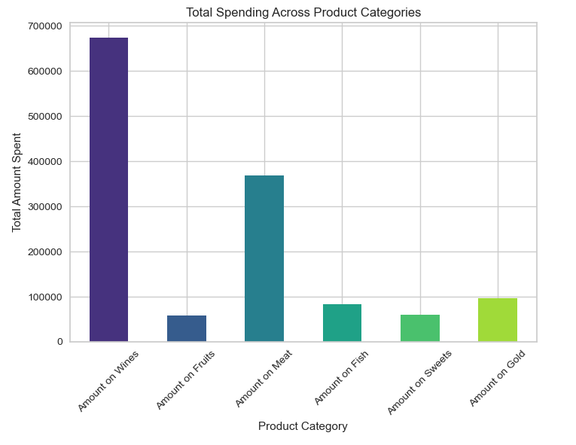
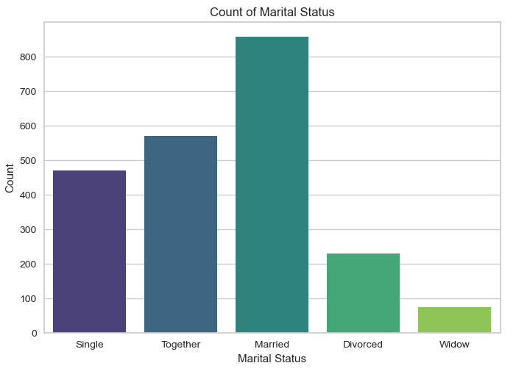
Exploratory Data Analysis Graphs

Slide 6
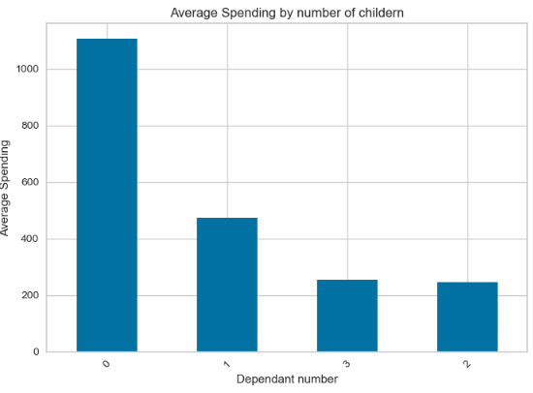
Exploratory Data Analysis Graphs

Slide 7
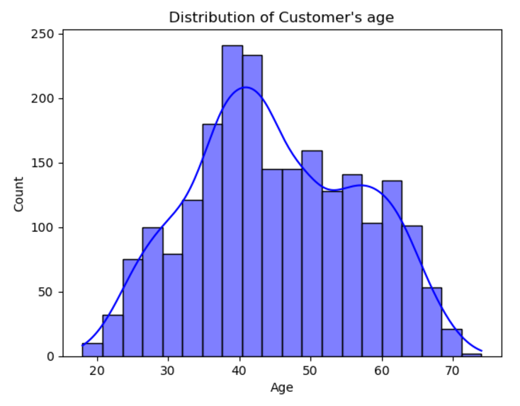
How Did We Approach This?
Model based on the attributes:
Income
Number of Children
Age
Marital Status
Product
Engagement in campaigns
Education

Slide 8
Choosing the Right Method
Since it is a clustering problem we tried lots of different methods (more than 10 different algorithms, parameters and features combinations) and concluded that Kmeans is our best option.
Scalability: Efficient for large datasets like ours.
Simplicity: Easy to interpret and deploy in future analyses.
Performance: Suitable for identifying well-defined groups.
How It Works:
Divides customers into k clusters based on similarities in features.
Each customer belongs to the group closest to their profile.

Slide 9
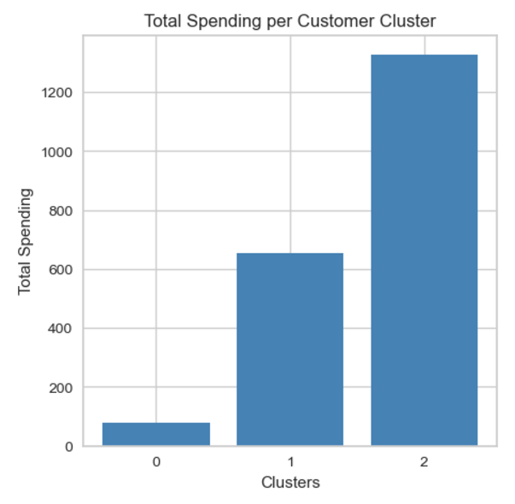
What Did We Discover? Results of Clustering
Clusters profiles:
Cluster 0: Low income, families with small children
992 customers
Cluster 1: Medium Income, families with teenagers
662 customers
Cluster 2: No kids, High Spenders
551 customers

Slide 10
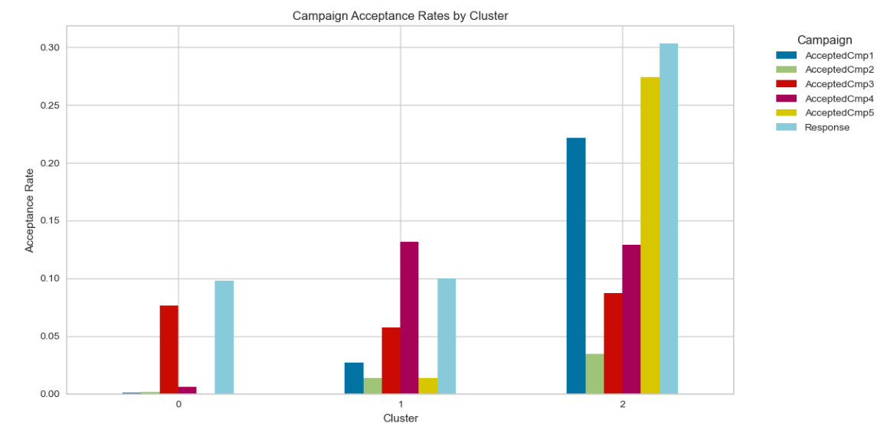
What Did We Discover? Campaign Feetback
Cluster 2 response rate is much higher.

Slide 11
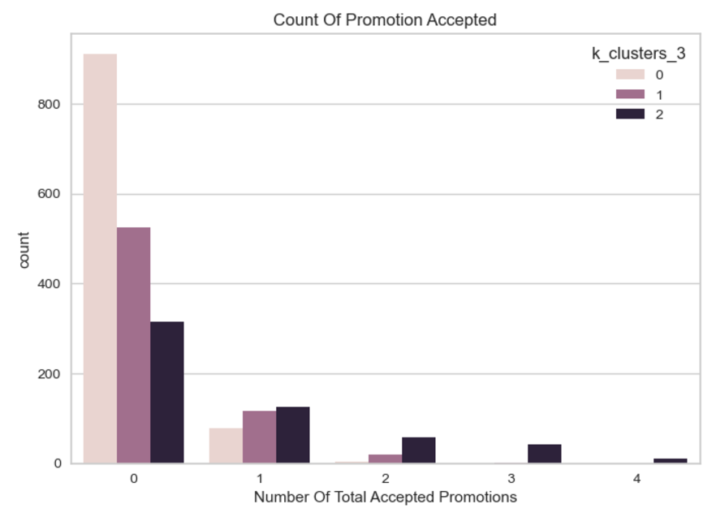
Recommended Campaign Strategy - Cluster focused campaigns
Current strategy: Generic. Very low conversion.
80% of our clients showed zero interest for our campaigns.
Refined strategy: Cluster focused.
Personalized campaigns depending on customer profile, to improve campaign response, increase loyalty and maximize revenue.

Slide 12
Next Steps- From Insight to Action
Actions for Marketing:
Evaluate Cluster Performance of targeted marketing campaigns.
For Data Science Team:
Monitor campaign performance and refine segmentation.

Slide 13
Thank you!

